Slide 1
Cookies Lack Integrity: Real-World Implications
Xiaofeng Zheng, Jian Jiang, Jinjin Liang, Haixin Duan,
Shuo Chen, Tao Wan and Nicholas Weaver
Present by Zeyi Tao

Slide 2
How Cookie Works
Interface: a key-value like browser-side storage to maintain states
Write: setcookie(name, value, expire, path, domain, secure, httponly)
Read: $_COOKIE[name]
Protocol:
Write as a response header
Stored as key-value
http://login.example.com/
Set-Cookie: user=alice; domain=“.example.com”; path=/; …
key value
http://www.example.com/
Cookie: user=alice; …
Matches cookie domain and path with the URL,
Only sends name-value pairs of all matching cookies.

Slide 3
Cookie’s Weak Access Control Policy
In the same origin policy of web, the origin is usually defined by protocol, domain, and port, isolating static/active content from different websites.
The origin of cookie only includes domain. In addition, if two domains share same suffix, the suffix may be used as cookie scope and is accessible by both domains.
Allows cross-domain and cross-scheme (HTTP to HTTPS) cookie injection.
Set-Cookie: value=bad; domain=.example.com
https://good.example.com/
http://evil.example.com/

Slide 4
Cookie Overwriting
A cookie can be directly overwritten if its domain scope is shared with an attacker from a related domain.
http://evil.example.com/
value=bad; domain=.example.com; path=/

Slide 5
Cookie Overwriting
A cookie can be directly overwritten if its domain scope is shared with an attacker from a related domain.
https://good.example.com/
Cookie: value=bad;
value=bad; domain=.example.com; path=/

Slide 6
Cookie Shadowing
Even a cookie is set with a more-specific domain, it still could be shadowed by a related domain attacker.
http://evil.example.com/
value=bad; domain=.example.com; path=/home
value=good; domain=good.example.com; path=/; secure

Slide 7
Cookie Shadowing
Even a cookie is set with a more-specific domain, it still could be shadowed by a related domain attacker.
https://good.example.com/home
Cookie: value=bad; value=good
value=good; domain=good.example.com; path=/; secure
…
// return the first cookie with given name
for (int i=0; i<cookies.length; i++) {
if (cookies[i].getName().equals(name))
return cookies[i];
}
…
value=bad; domain=.example.com; path=/home

Slide 8
Motivation
To understand the real-world impact of cookie injection attacks.
In practice, how could an attacker inject malicious cookies into an HTTP/HTTPS session?
What kind of attacks could be caused by injecting cookies?
What should we do? are there possible protocol changes to improve cookie's integrity while not to break existing websites?

Slide 9
Pitfalls in Cookie Implementations
Uncovered Implementation Quirks
Browser-side Cookie Priority
Sever/Script-Side Cookie Preference
Cookie Storage Limitation
Cookie Header Size Limit
Cookie Name
Cookie Path
Uncovered Vulnerabilities
Vulnerabilities in Handing Proxy Response
Vulnerabilities in Handing Public Suffixes in Safari
Vulnerabilities in Safari‘s HSTS Implementation

Slide 10
Uncovered Implementation Quirks

Slide 11
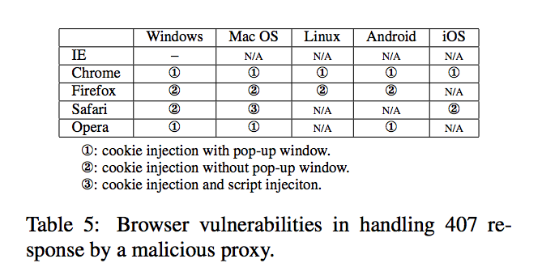
Uncovered Vulnerabilities
Vulnerabilities in Handing Proxy Response

Slide 12
Real World Exploitations
Using cookie as authentication tokens
Use cookie to identify a user session
Reflecting cookies into HTML
Unsafe implementation of auxiliary variables: preferred language, username etc.
Associating important and session independent states with cookies
Session fixation

Slide 13
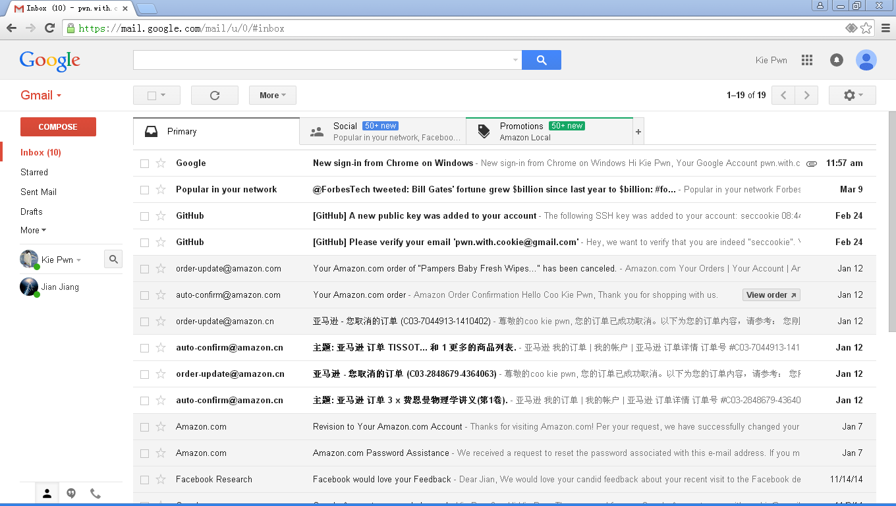
Cookies as Authentication Tokens
The attacker can selectively shadow session cookies to attribute certain activities to the attacker.
https://mail.google.com/a
https://chat.google.com/b
sessioncookie; domain=“chat.google.com”; path=/b

Slide 14
Reflecting cookies into HTML
Every request may bring different cookie values, no matter how you set cookies previously.
https://secure.boa.com/login
clean cookie
with path “/”
Set-Cookie: value=good;path=“/”
secure.boa.com/myaccounts
Cookie: value=xss; value=good;
“/login”:
1. Cookie Validation
2. Set Cookie with “/login”, redirection
----------------------------------------------------
“/myaccounts”:
(Cookie Validation missed!)
1. Read Cookie from “/myaccounts”
xss payload cookie
with path “/myaccounts”

Slide 15
Associating important and session independent states with cookies
Shopping cart tracking/manipulation on popular E-commerce websites
Browsing history and purchase tracking/hijacking on Amazon
Tracking of all purchases
Potential hijacking of purchases

Slide 16
Possible Defenses
Existing Solutions
Full HSTS and Public Suffix List
Defensive Cookie Practices
Anomaly Detection
Our Browser Enhancements
Mitigating Active Network Attackers
Mitigating Web Attackers

Slide 17
Browser Enhancements
A browser MUST NOT accept a cookie presented in an HTTP response with the secure flag set, nor overwrite an unexpired secure cookie
Cookies with the secure flag MUST be given higher priority over non-secure cookies.
A browser MUST only send the highest priority cookie for any cookie name.
In removing cookies due to a too-full cookie store, the browser MUST NOT remove a secure cookie when there are non-secure cookies that can be re moved.
The browser MUST allow an HTTP connection to clear a secure cookie .
The browser MUST NOT send a cookie with the “do not send” flag, nor send any non-secure cookie with the same name.

Slide 18
Conclusions
We provided an evaluation of potential susceptible websites to cookie injection attacks.
We examined both browser-side and server-side cookie implementation, in which we found several browser vulnerabilities and a number of non- conforming and/or inconsistent implementations.
We demonstrated the severity and prevalence of cookie injection attacks in the real world.
We developed and implemented browser-side enhancements to provide better cookie isolation.

Slide 19
Questions
According to authors work, give one example common cookie usage which often lead to cookie injection attacks if specific defensive measures are not in place.
Why network cookies are unsafe?(open questions)
Is there any possible solution but without using cookies?(open questions)

